Slide 1
Data Warehouse Approaches

Slide 2
Key terms
OLTP – Online transaction processing
OLAP – Online analysis Processing

Slide 3
Decision Support
To support strategy
Objectives
KPI (Key Performance Indicators)
To evaluate the business or a department
Again objectives, KPIs, data to support, inform
To investigate
What’s going on… not necessarily data driven objectives
Note: The concept of ‘measure’, dimensions
Terms: Data driven, add insight, inform, analytics, reporting db

Slide 4
Decision Support ‘System’ DSS
A ‘system’ to support strategy
Includes projects, processes
Terms: Business Intelligence, Data warehousing, business reporting, enterprise

Slide 5
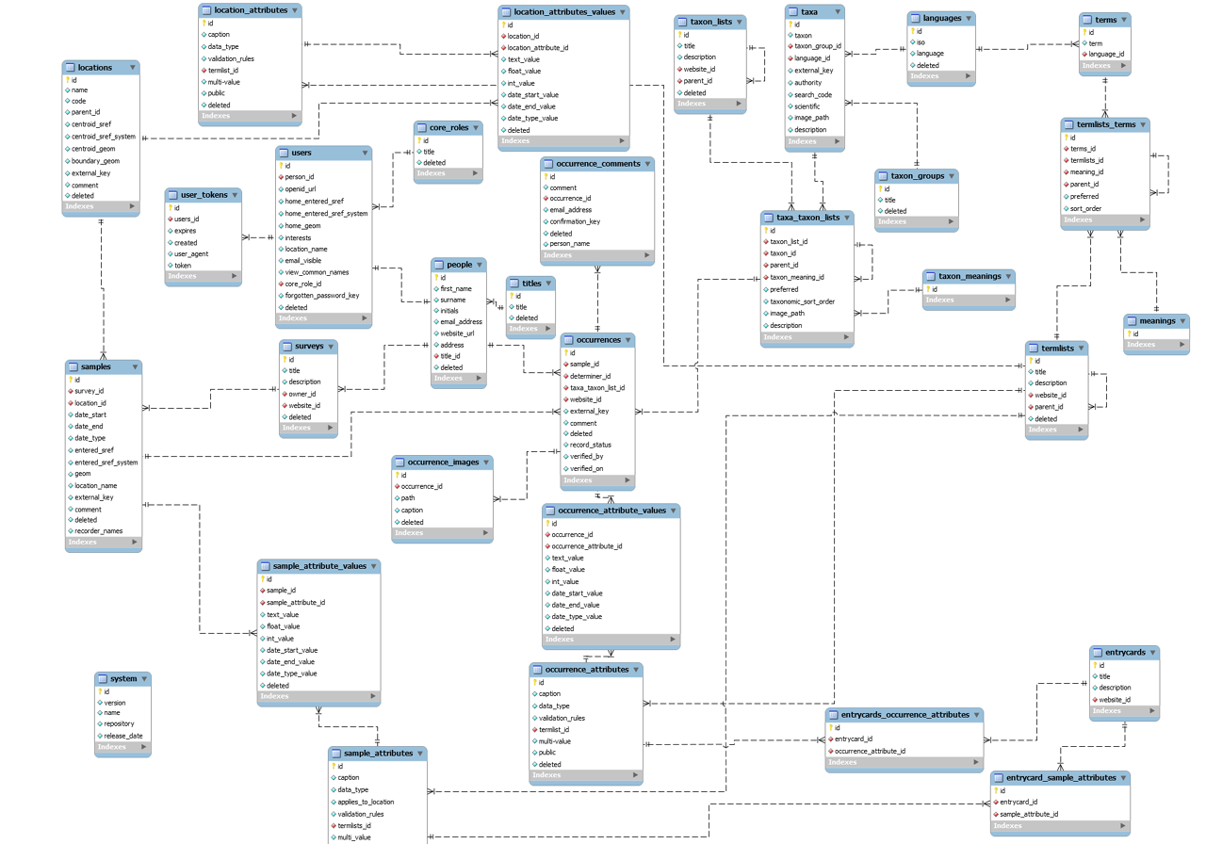
Normal OLTP db

Slide 6
Consider a Claims db
For reporting year on year
No of premium customers per year
No of new premium customers per year
No of premium customer by level each year
No of new premiums by level each year
Measure and Dimensions

Slide 7
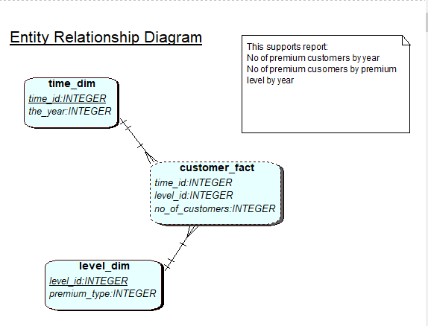

Slide 8
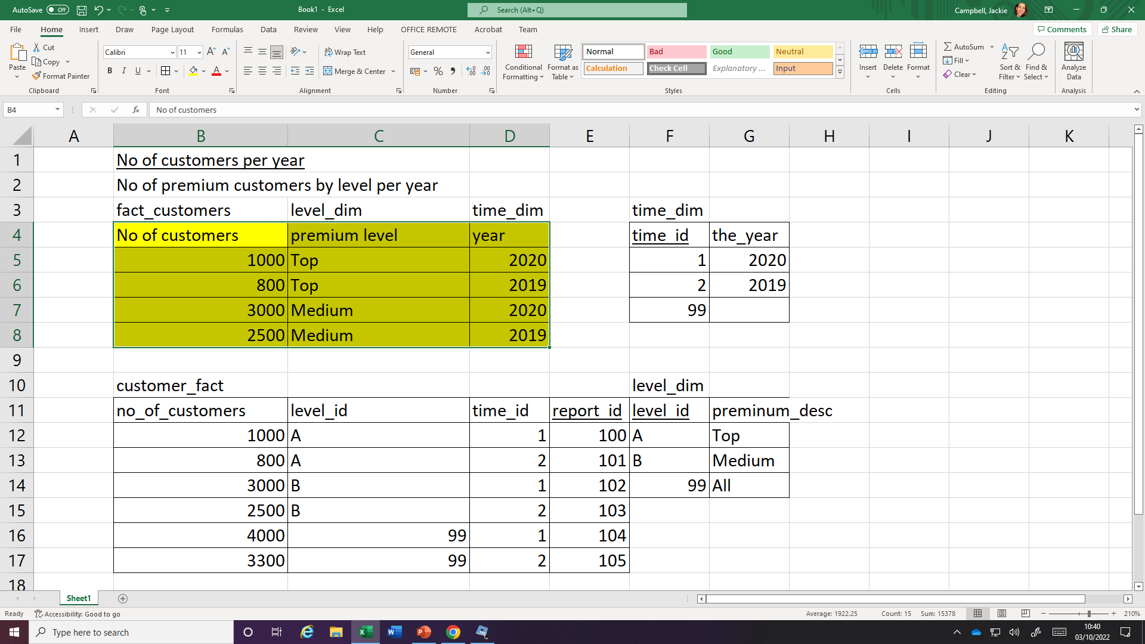
Data for the above

Slide 9
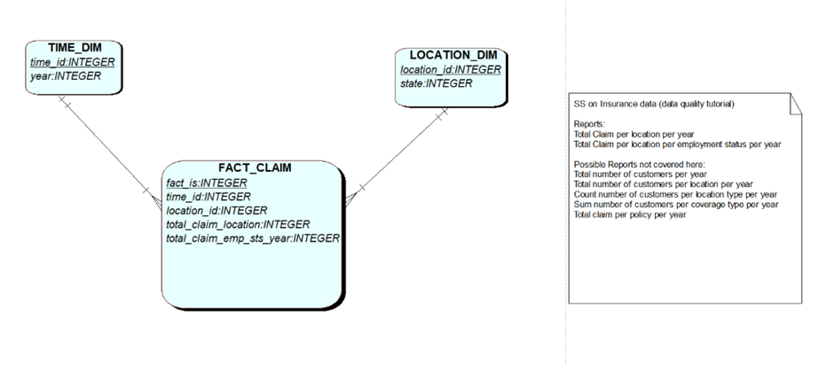
Claims – data mart using a star schema model (another example)

Slide 10
No of crimes per year

Slide 11
Lets look at the Groceries – facts, dimensions SS_Claims db in Apex/SQL
For reporting year on year

Slide 12
Looking at Claims, consider
Who are the users for this system?
The number of users for this system?
How significant is the speed of retrieval?
How many records on the fact_claim table? After 5 years, 20 years?
How many records on the time_dim table? After 5 years, 20 years?
How is this data maintained?
Is this data normalised? Is that good?

Slide 13
OLTP/OLAP (decision support) Why Separate the Data Warehouse?
High performance for both systems
DBMS— tuned for OLTP: access methods, indexing, concurrency control, recovery
Warehouse—tuned for OLAP: complex OLAP queries, multidimensional view, consolidation.
Different functions and different data:
missing data: Decision support requires historical data which operational DBs do not typically maintain
data consolidation: DS requires consolidation (aggregation, summarization) of data from heterogeneous sources
data quality: different sources typically use inconsistent data representations, codes and formats which have to be reconciled

Slide 14
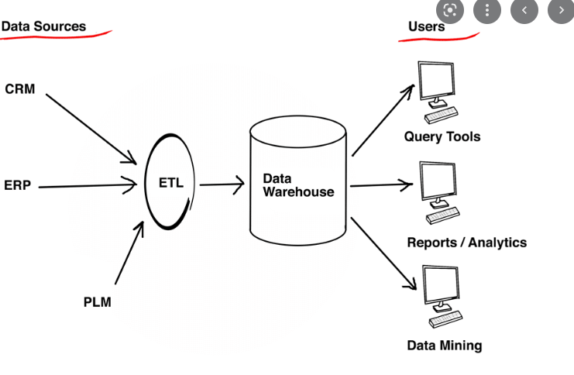
Simplified ETL/DW solution

Slide 15
“A data warehouse is a
subject-oriented,
integrated,
time-variant,
and nonvolatile collection of data in support of management’s decision-making process.”—W. H. Inmon

